Slide 1
Android Activities

Slide 2
Activities
Represent the screens in your Android application
Divided into two pieces:
The UI layout (normally defined in an xml file with a combination of regular widgets (views) and ViewGroups (containers for other views)
The ActivityXXX.java file is where you select and inflate the view for the activity and put your event handling code for the activity and it’s view objects.
Layouts are reusable

Slide 3
Qualified Layouts
Can have separate layouts for different orientations (portrait vs landscape) different screen heights and widths, etc.
Example:
GeoQuiz/QuizActivity

Slide 4
The Activity Lifecycle
Activities have a lifecycle, controlled by the Android system
Things that cause lifecycle/activity state changes:
Creation of a new activity
Activation (manually or programmatically) of an activity that wasn’t active before
Rotation of the device
Interruptions from other apps (i.e. phone calls)
Low memory
Other

Slide 5
The Six Main Activity Callbacks
protected void onCreate(Bundle savedInstanceState)
When the system first creates the activity (set the UI/content view here)
protected void onStart()
Makes the activity visible to the user (usually no need to implement)
protected void onResume()
Activity is in the foreground and ready for the user to interact with it
protected void onPause()
First indication that the user is leaving the activity. It is no longer in the foreground.
protected void onStop()
Activity is no longer visible to the user
protected void onDestroy()
Activity is about to be destroyed (either because it is finished or there was a configuration change—most commonly a rotation of the device)

Slide 6
Additional Callbacks
protected void onRestart()
Called if the activity was stopped but not destroyed, and is now being restarted
The activity was not active but is about to become active
onStart() will be called next
protected void onSaveInstanceState(Bundle savedInstanceState)
Called between onPause() and onStop()
Provides an opportunity to save state so it can be restored after a configuration change (i.e. rotation)

Slide 7
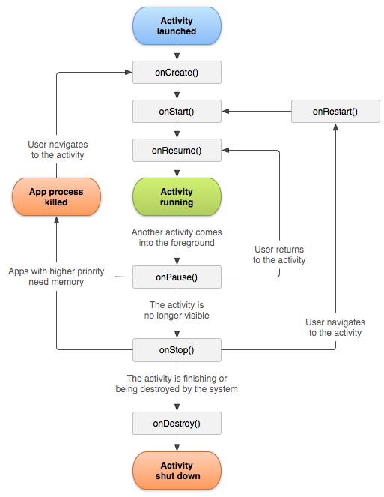
onSaveInstanceState(Bundle)
Additional Info:
https://developer.android.com/guide/components/activities/activity-lifecycle

Slide 8
Activity Lifecycle Demo
GeoQuiz
Set logcat to “Debug” and filter on “QuizActivity”
Observe the output for the following changes
Initial creation
Rotation
Use of ”recents” button to make another app active
Use of “home” button
Use of “back” button

Slide 9
Saving and Restoring Instance State
Use the onSaveInstanceState(Bundle) callback to save state in an activity record before it is lost due to a configuration or other short-term change
Doesn’t work for long-term storage (activity records are removed when the user hits the ‘back’ button, when an activity is destroyed, when the device is rebooted, or when the activity hasn’t been used for a while)
Default (inherited) implementation saves state for all UI components. Doesn’t save state for instance variables.
Use the Bundle passed to onCreate(Bundle) to restore state
Be sure to check for a null bundle. If it’s null, there’s no saved state to restore.
Example
GeoQuiz/QuizActivity.java

Slide 10
Starting An Activity
Start an activity (from another activity) by creating an instance of the Intent class and passing it to the startActivity(Intent) method
startActivity(Intent) is defined in the Activity class
Example:
Intent intent = new Intent(QuizActivity.this, CheatActivity.class);
startActivity(intent);
We usually create intents from an inner class event handler, so this is a reference to the containing activity.
The activity we want to start.

Slide 11
Starting an Activity and Passing Data
boolean answerIsTrue = mQuestionBank[mCurrentIndex].isAnswerTrue();
Intent intent = new Intent(QuizActivity.this, CheatActivity.class);
intent.putExtra(EXTRA_ANSWER_IS_TRUE, answerIsTrue);
intent.putExtra(EXTRA_CHEATS_REMAINING, cheatsRemaining);
startActivity(intent);

Slide 12
Retrieving Data from an Intent
Intent intent = getIntent();
boolean isAnswerTrue = intent.getBooleanExtra(EXTRA_ANSWER_IS_TRUE);
This would be available to the activity that was called

Slide 13
Returning Results from an Activity
Calling activity calls startActivityForResult(Intent, int) instead of startActivity(Intent)
See GeoQuiz/QuizActivity (lines 105-110)
Called activity creates an Intent, puts result data in the intent as intent extras (if needed), and calls setResult
setResult(int resultCode)
setResult(int resultCode, Intent data)
See GeoQuiz/CheatActivity.setResult(…)
Calling activity provides an onActivityResult(…) callback method
See GeoQuiz/QuizActivity.onActivityResult(…)

Slide 14
Applications to Family Map Client
Main Activity (MapFragment)
PersonActivity is started when event info is clicked (person or personId is passed as intent extra)
Search and Settings activities are started when the menu items are clicked
Depending on how you implement them, Settings and Filter activities may return results indicating any changes made by the user
PersonActivity
Clicking a person starts another PersonActivity with the Person or personId passed as an intent extra
Clicking an event starts an EventActivity with the Event or eventId passed as an intent extra

Slide 15
Applications to Family Map Client
SearchActivity
Clicking a person starts a PersonActivity with the Person or personId passed as an intent extra
Clicking an event starts an EventActivity with the Event or eventId passed as an intent extra
SettingsActivity
Logout goes back to MainActivity

